Slide 1
App Enabled Pool Light Controller
Kevin Alber

Slide 2
Pool Light Operation (Hayward, SAVI, Pentair)
These three brands likely have over 90% of the market
The color on each light is changed by cycling the power once.
The first light in the sequence can be chosen by power cycling for a designated amount of time(different on each light)
All control systems are designed to control either a 120V or 12V light

Slide 3
Current Competition
Remote or app-based controller is not available for less that $1200 retail. This route still doesn't allow “smart-switching”, meaning user must cycle power until desired color is found.
Wired options available for ~$300 retail with “smart-switching” however requires a high voltage electric run which is ugly and expensive
As of May ‘17 Hayward has shown us that they are working on a product that would control a pump, lights, heater, 1 GVA for $250. No estimated release date.

Slide 4
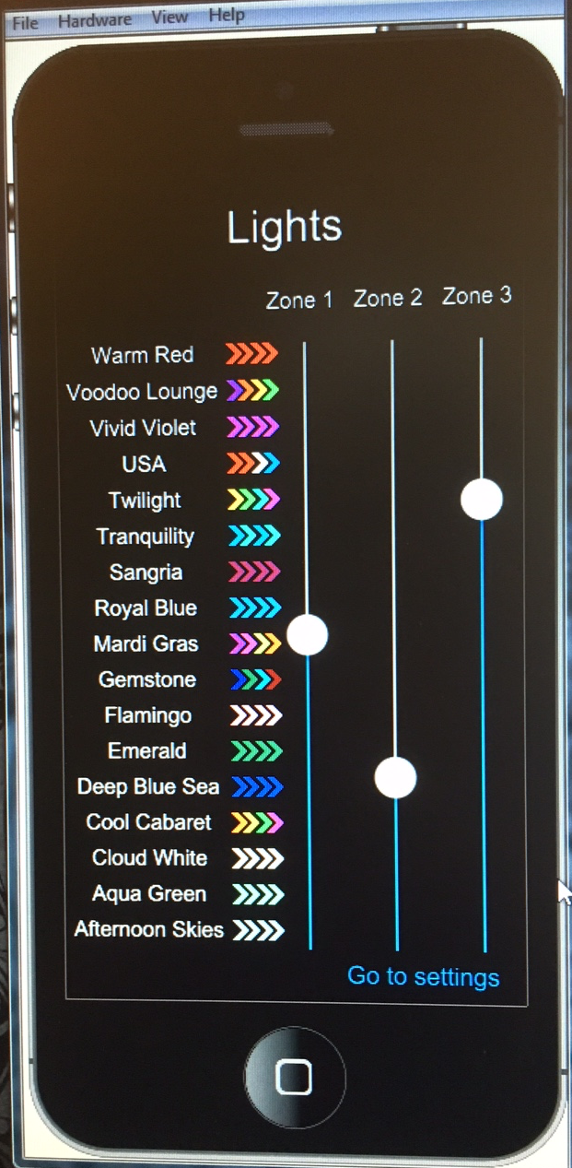
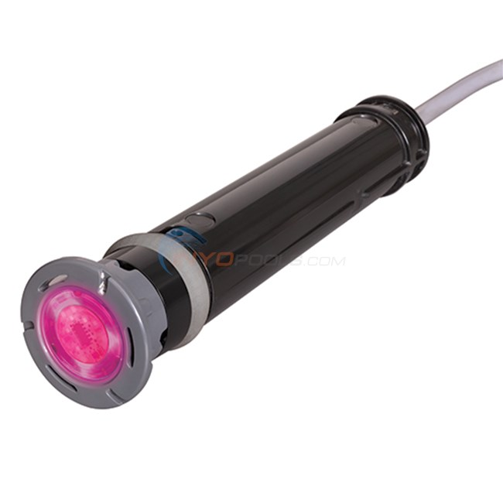
The Design
App
Server
Hosted on AWS
Allows for unique users
Instant update
Router
(Supplied by H/O)
WiFi
14VAC input required, color changes to the next color in the sequence after each power cycle
Control Module
Will need to convert power to DC to run board
Power Transformer (120VAC to 14VAC)
14VAC
14VAC

